Slide 1
Private Sector Best Practices and Solutions for Servicing the Industry
By
Ranti Omole
Chairman – Radial Circle Group
Vice Chairman – PETAN ( Petroleum Technology Association of Nigeria)

Slide 2
RADIAL CIRCLE TECHNICAL SERVICES LIMITED
Established in 1995.
Offshore experiences since 2003 – Shell Bonga FPSO/Rigs/PSV/Platforms
Angola, Ghana, Nigeria ,Uganda, Mozambique and Senegal
Engineering, Procurement, Integration, Installation, Commissioning and Post Installation support and maintenance services.
Offshore Telecommunications solutions
Navigation and Marine Electronics
Surveillance and Security Solutions
Safety Management Systems –IFG / PAGA
Assets Integrity and Condition Monitoring systems – Metocean, Risers Monitoring System, etc.
Instrumentation
Electrical Systems.
#UIOGS

Slide 3
Introduction-PETAN
PETAN - an association of leading Nigerian Indigenous Technical Oilfield service companies supporting the upstream, midstream, and downstream sectors of the oil & gas industry
Formed in 1990, the association was created to bring together Nigerian Oil & Gas entrepreneurs and to create a forum for the exchange of ideas with the major operators, industry stakeholders and policy makers.
PETAN membership comprises over 100 service companies involved across the entire value chain of upstream, midstream and downstream subsectors of the oil and gas industry.

Slide 4
PETROLEUM TECHNOLOGY ASSOCIATION OF NIGERIA
(ASSOCIATION OF LOCAL SERVICE PROVIDERS)
Year founded 1990
No of companies 100
Technical services offered > 250
Nigerians employed > 20,000
Cumulative employment impact >100,000

Slide 5
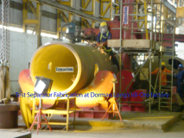
PETAN: WIDE SPECTRUM OF CAPABILITIES
Drilling, Completions and Well Services
Fabrication and Manufacturing
Management and Information Systems
EPCI- Projects, Construction and Installations
Pipelines, Facilities and Process Systems
Production and Operations
Reservoir, Geophysics and Geosciences
Training and Human Development
Safety Systems and Certifications
Project Management
Offshore Services and Vessels
Engineering Design (FEED and Detailed)

Slide 6
THE KEY STAKEHOLDERS
Local Content
Operators and Concessionaires
Local Service Providers’
MAIN EPC
Sub-Contractor
Government

Slide 7
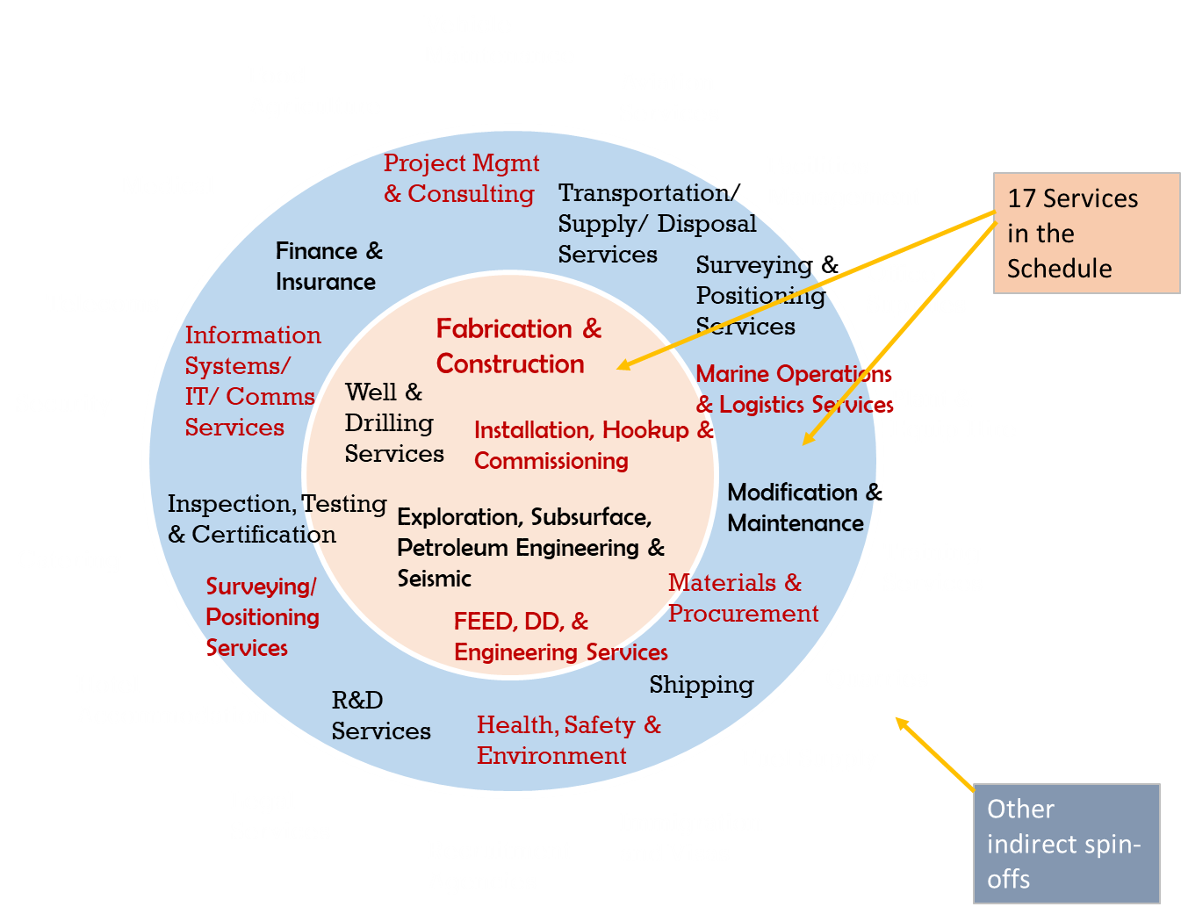
Service Opportunities in the O&G Sector.
Compliments of NCDMB
Namibia – Ultra deep offshore
300 miles , 3000m above sea level.
FPSO for oil and FLNG for gas.
Topside of the vessel and subsea pipelines.
Logistics vessels, Pipe playing vessels, Umblicals, Flow lines & Risers etc.
Post installation supports + > 25 years. Several years sustainable revenue.

Slide 8
Best practices and strategies to develop resilient local service providers.
Focus on business areas that are not the strength of the multinationals or usually subcontracted out to third parties.
Strategic partnership with multinationals EPC and Regional service providers in projects in order to develop niche capacities & technical capabilities.
Invest in assets acquisitions to support services and also in manpower development in order to compete in niche areas identified.
Maximising the local content opportunities and showing capabilities to exceed regulatory targets.
Flexibility and adaptability as strength to compete effectively in areas where multinationals are rigid and offering standard solutions.
Use local business environment understanding, logistics and operational efficiencies to the strength of your business.
#UIOGS

Slide 9
Best practices and strategies to develop resilient local service providers.
Providing reliable and top-quality services to customers to build goodwill.
Developing company to international standards and certifications – ISO 9001:2015, ISO 14001, ISO 45001, offshore work environment and safety certifications, etc.
Realistic capacity assessment and utilising external technical support to overcome competency deficiencies .
Collaborate with other regional and local companies with specialised competence in order to leverage on areas of deficiencies to execute projects.
Good staff retention and employee compensation plan in order to retain the human capital
#UIOGS

Slide 10
CONCLUSION
All stakeholders must work together to build the local content and service providers
Quality and Technical depth of service providers depend on the pedigree of the business founders.
Patronizing local service providers on the long run is cost effective.
Local service providers must take advantage of opportunities to invest gradually in capacity and human capital.
Ensuring non-resident OEMs have local agents or partners very key for Post Installation Support – assure continuous inflow till end of production.
Regional collaboration with more experienced service providers in Africa –key to capacity development
Focus on quality , timely service delivery and safe practices

